Slide 1
AI PLAYS GAME USING NUERAL NETWORK

Slide 2
PREDICTION MODEL
Q Learning
Reinforcement Learning

Slide 3
Q Learning
It is a reinforcement learning technique, where we try to approximate a special function which drives the action-selection policy for any sequence of environment states.
Goal is to learn a policy which tells an agent what action to take under what circumstances.
Q-learning is a model-less implementation of Reinforcement Learning where a table of Q values is maintained against each state, action taken and the resulting reward.
Does not require model of environment
Handle problems with stochastic transitions and rewards, without requiring adaptations
Here, the states are game screenshots and actions, do nothing and jump[0,1]

Slide 4
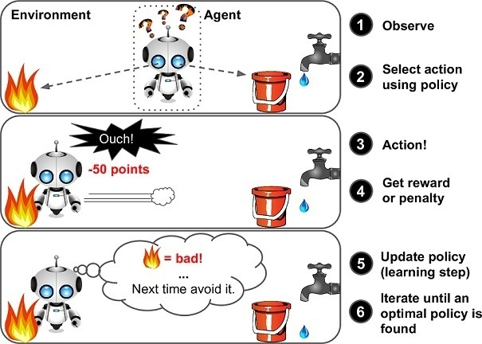
Reinforcement Learning
Each and every one of us has learned to walk using the concept of Reinforcement Learning (RL) and this is how our brain still works.
In the analogy of child’s walk, a positive reward would be a clap from parents or ability to reach a candy and a negative reward would be no candy. The child then first learns to stand up before starting to walk.
Dino, is to maximize a certain numeric reward by performing a particular sequence of actions in the environment.
The biggest challenge in RL is the absence of supervision (labeled data) to guide the agent.
It must explore and learn on its own. The agent starts by randomly performing actions and observing the rewards each action brings and learns to predict the best possible action when faced with a similar state of the environment

Slide 5
ALGORITHMS
Game Module
class Game:
def __init__(self):
self._driver = webdriver.Chrome(executable_path = chrome_driver_path)
self._driver.set_window_position(x=-10,y=0)
self._driver.get(game_url)
def restart(self):
self._driver.execute_script("Runner.instance_.restart()")
def press_up(self):
self._driver.find_element_by_tag_name("body").send_keys(Keys.ARROW_UP)
def get_score(self):
score_array = self._driver.execute_script("return Runner.instance_.distanceMeter.digits")
score = ''.join(score_array).
return int(score)

Slide 6
ALGORITHMS
DinoAgent
Game State
class DinoAgent:
def __init__(self,game):
self._game = game;
self.jump();
def is_crashed(self):
return self._game.get_crashed()
def jump(self):
self._game.press_up()
class Game_sate:
def __init__(self,agent,game):
self._agent = agent
self._game = game
def get_state(self,actions):
score = self._game.get_score()
reward = 0.1
is_over = False
if actions[1] == 1: #else do nothing
self._agent.jump()
image = grab_screen(self._game._driver)
if self._agent.is_crashed():
self._game.restart()
reward = -1
is_over = True
return image, reward, is_over

Slide 7
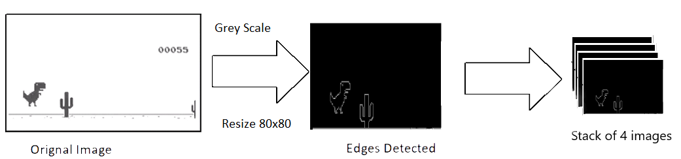
ALGORITHMS
Image processing
def process_img(image):
image = cv2.cvtColor(image, cv2.COLOR_BGR2GRAY)
image = image[:300, :500]
return image

Slide 8
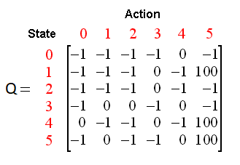
DATASET

Slide 9
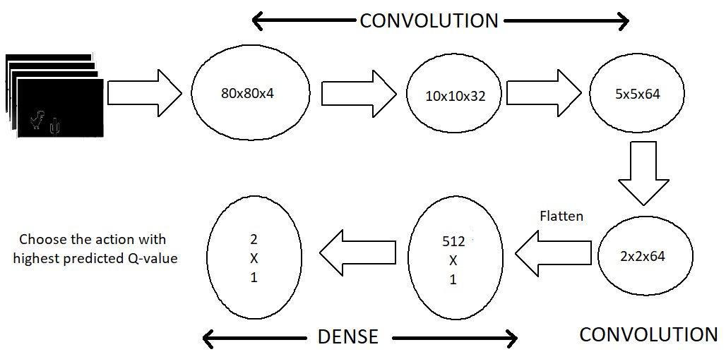
MODEL ARCHITECTURE

Slide 10
EXPECTED OUTCOME
At the end Dino will learn to play the game.

